Slide 1
Visualisation tasks

Slide 2
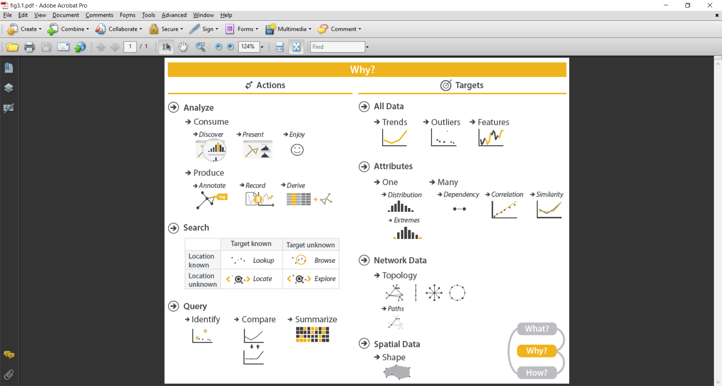
From “Visualisation Analysis & Design”,
T. Munzner,
CRC Press, 2015
(Chapter 3)
Notes:
Note that this is not a formal and precise division into independent kinds of tasks.
Sometimes the edges or differences are a little blurry or inexact, and a particular example might be categorised in more than one way.
The point, though, is not such exact division. It is to make us think about how broad or narrow our system design requirements are, before we decide on exact technical details.
In particular, note that these tasks are like design requirements. Each one can be implemented in many different ways, and they are not specific to any one language or toolkit or even type of visualization.

Slide 3
Three different actions
Given a visualisation of a data set, a user can:
Analyse:
consume or produce
Search:
location/target is known/unknown?
Query:
find specific information about a target

Slide 4
The Analyse action
Consuming: user simply accesses the data using the visualisation
to discover information not known before
to present information to another person
enjoy and find something interesting
Producing: user actively creates something
annotations of the data or the visualisation
a persistent record of a visualisation (or aspects thereof)
derive new data based on existing data

Slide 5
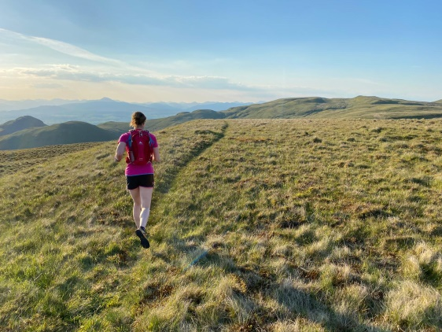
Running example: Analyse
Discover: did anyone win both the TBHR and the Highland Fling in 2010?
Present: here are the first Swandling club finishers for the TBHR in 2012
Enjoy: a racer, seeing how races have changed in many years, and looking for anyone they know
Annotate: Mary Smith is the same person as Mary Bernados
Record: this chart on my wall shows how much faster I have become in the Ben Lomond race over the past ten years
Derive: calculate the percentage of active women in each club in each year

Slide 6
The Search action
Locating target of interest in the visualisation
Lookup: target known & location known (where and what)
Browse: target unknown & location known (where)
Locate: target known & location unknown (what)
Explore: target unknown & location unknown

Slide 7
Notes:
Imagine this was the race data that you were looking at… with position as the height of the bar, and the initials of the name of the runner as the label below each bar.
There are many kinds of searches that a system could support, and we can map out examples of them here

Slide 8
Running example: Search
Lookup: what position did John Thomas (JT) come in? (4)
Browse: who won the race? (SB)
Locate: did CG run this year? (no)
Explore: is there any noticeable pattern? (no)
Notes:
Noting that it is the nature/form of the visualisation that will determine what is meant by ‘location’ – if it is location in the perceived visualisation (or simply a location in a data source)

Slide 9
The Query action
Once you have found the data you are interested in, what will you do with it?
Identify: get all the information about it
Compare: assess differences between multiple data items
Summarise: produce an overview of multiple data items
Notes:
Summarise here means creating something new, in a semi-automatic way, from the raw data items in the set of query results. It might, for example, be a heat map or chart that compresses the set in some useful way, or a simple statistic based on that data set, or even representative sample.

Slide 10
Running example: Query
Identify: What club was the TBHR 2015 winner from?
Compare: Was ND faster than DF?
Summarise: Of the first ten finishers, three were women

Slide 11
Targets
Targets are the ‘things of interest’ in a visualisation
Targets are not necessarily just the individual data points (although this is common)
for all data: trends, outliers, features
for attributes: distributions, dependencies, correlations, similarities
for network data: topology, paths
for spatial data: shape

Slide 12
Targets (things of interest) over all data
Trends:
patterns: e.g. increase, decrease, plateau, etc.
Outliers:
data points that don’t fit into an obvious pattern
Features:
Clusters and other structures of interest, depending on the domain

Slide 13
Running example: Targets over all data
Trends:
JD’s finishing time in the TBHR decreased suddenly in the early 2010’s , but recovered later in the decade
Outliers:
the winner’s time in 2015 was much slower than in all other years
Features:
there are more females finishing in the first 25 places in the past four years than in the whole decade before that

Slide 14
Targets (things of interest) relating to Attributes
For the values of one attribute:
distribution
For the values of more than one attribute
dependency, correlation, similarity

Slide 15
Running example: one attribute target
Distribution: the number of runners per age category
Extremes: the number of runners over 70yrs

Slide 16
Many Attribute Targets
Dependency: the value of one attribute can be determined directly by the value of another
Correlation: there is a tendency for the value of one attribute to be linked to the value of another
Similarity: attributes ranked according to their similarity (as defined by quantitative aggregates)

Slide 17
Running example: many Attribute Targets
Dependency: a runner’s category (e.g. M40) is directly dependent on age & gender (e.g 42yrs, male)
Correlation: there is a trend for a runner’s finishing time to relate to their weight
Similarity: the average finish time for the Ben Osmand Race is closer to the average finish time for the Ben Styles Race than it is to the Ben Rinnes Race

Slide 18
Targets (things of interest) in specific data sets
For network data
topology (structure of the network)
paths (sequences of connections between nodes)
For spatial data
Shape (intersection, containment…)

Slide 19
Running example: Specific data set targets
Network of run-buddies
topology: are there small groups of runners who always train with each other? If so, how many?
paths: if JH has training advice that he gives to the people he trains with, will that advice get to BK?
A race where runners have to pass through a set of checkpoints
shape: what is the perimeter length of the shape created by these checkpoints, when they are connected by straight lines on a map?

Slide 20
Why is it useful to describe data types and visualisation tasks in such an abstract way?

Slide 21
Why is it useful to describe data types and visualisation tasks in such an abstract way?
It is always good to pause and think about your data, and its use
Decisions you make in your visualisation for one domain can be compared or used with those needed for another domain

Slide 22
Running example scenario
I want to join a Hill Running Club that has an equal balance of gender membership, a wide distribution of members with different age categories, some very fast runners, and a dense network of run-buddies.
A generic visualisation tool that supports a good variety of tasks should allow me to find this information easily
Notes:
This is to make us consider what should be in a generic system that supports the varied tasks described in this lecture

Slide 23
Looking for a data item (club) which is a categorical attribute of other data items (runners).
Looking at the frequencies of an attribute (distribution of the genders of the members) for each of a set of data items in a table (clubs), and compare.
Looking at the frequencies of an attribute (distribution of the age categories of the members) for each of a set of data items in a table (clubs), and compare.
Deriving new data (calculating the average) of a quantitative attribute (finishing position) for each of a set of data items in a multi-dimensional table (runners in clubs), and compare.
Looking at the structure of a set of networks (run-buddies) to identify information about them (the extent of connectivity), and compare.

Slide 24
A similar example
I need to choose which companies to apply to for a job. I want a company that offers relatively high salaries for the sector and has strong social ties between its employees. I would like there to be an equal gender balance, and for there to be options for me to work in different countries.
If I load the relevant data into the same visualisation system, will I be able to find this information easily?
Notes:
I’d hope so… as the high level tasks here are basically the same, even if the data and terminology are not the same

Slide 25
Summary
Actions (verbs): things a user can do
analyse, search, query
Targets (nouns): things a user can be interested in
all data
trends, outliers, features
attributes
distribution, dependency, correlation, similarity
networks
topology, paths
spatial data
shape

Slide 26
Visualisation tasks

